Slide 1

Structure and Function of the Human Heart
An introduction to how the human heart works

Slide 2
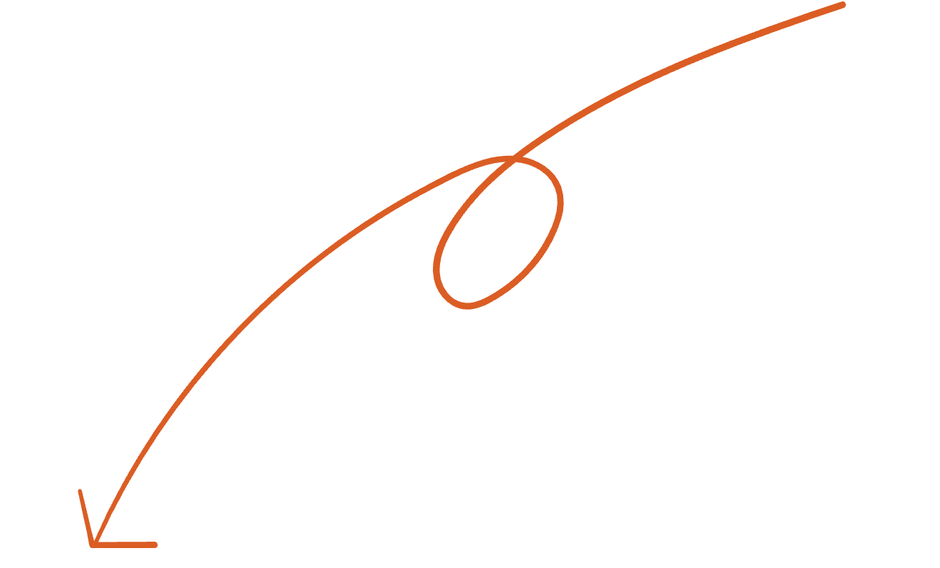
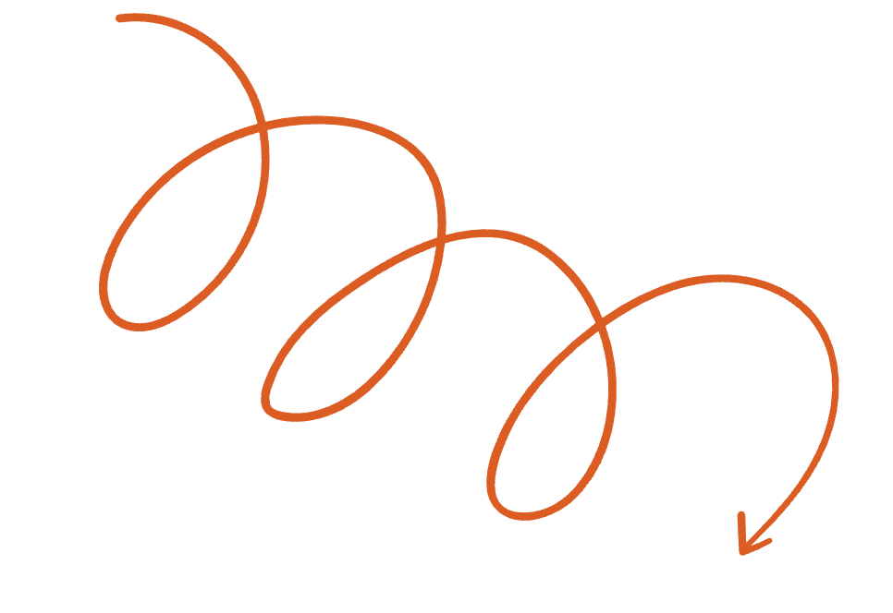
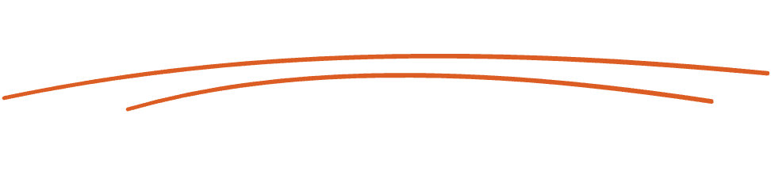
Contents
Anatomy of the human heart
How the heart works
The four chambers
Types of blood vessels
Layers of the heart wall
How blood flows
The electrical conduction system

Slide 3
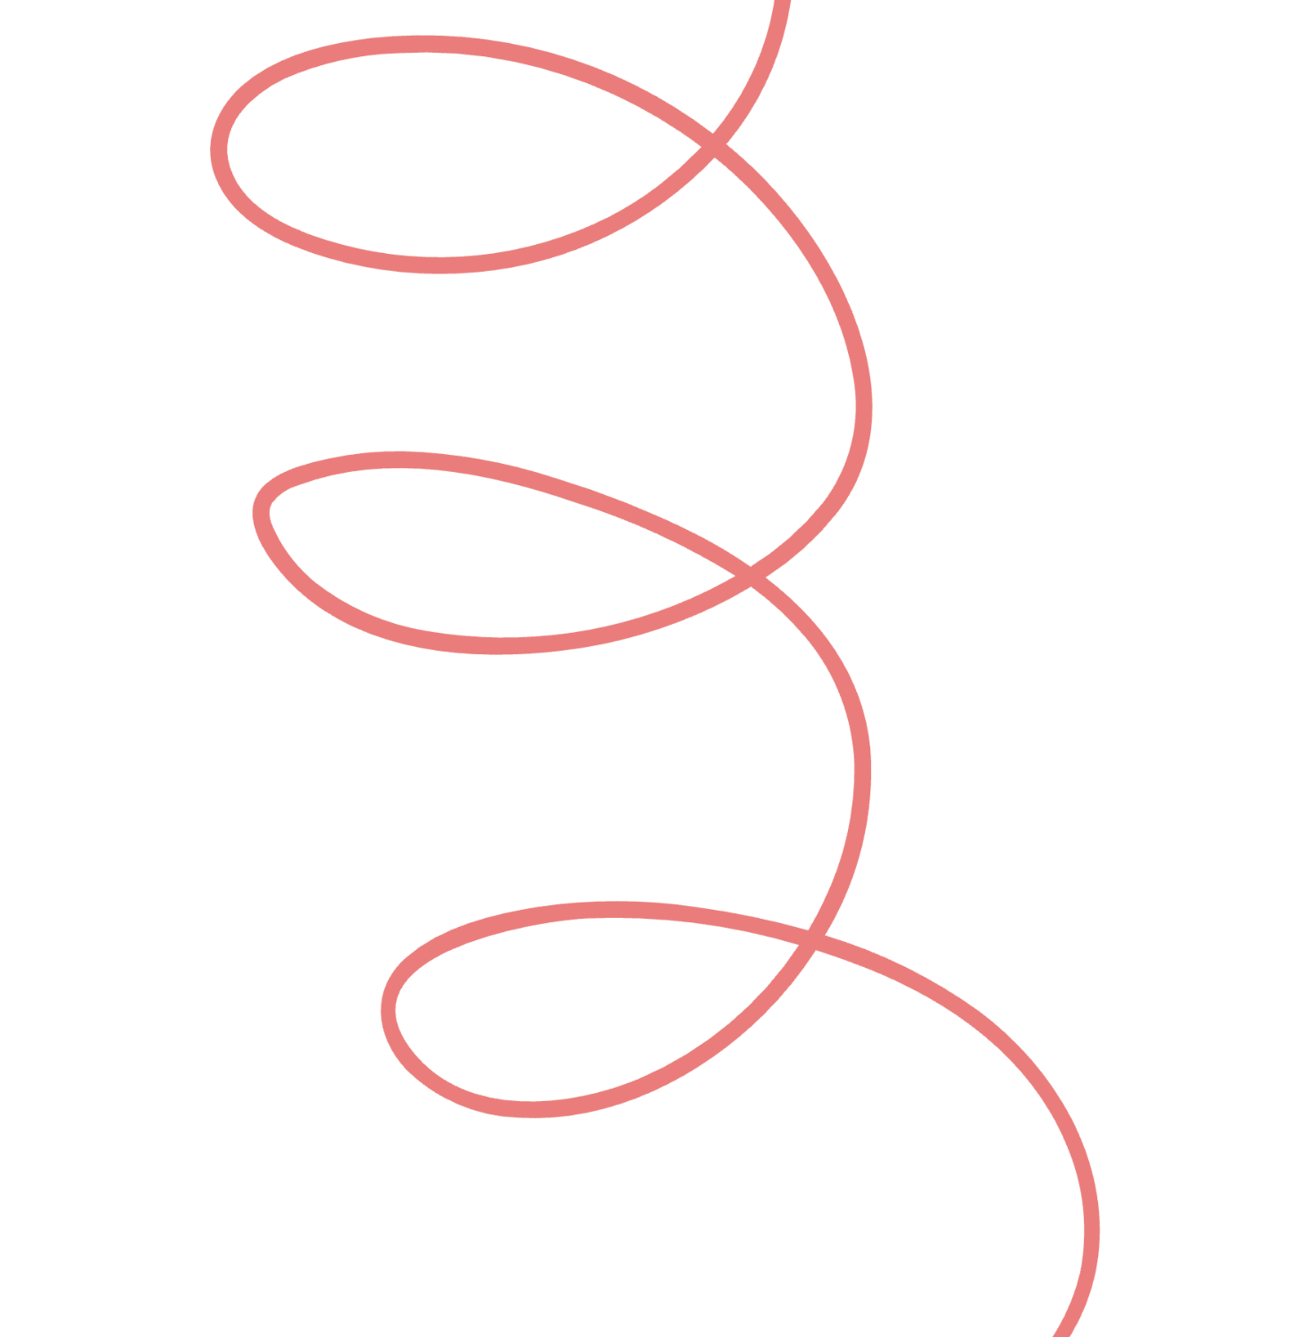

The human heart
Introduce the heart’s location in the body, its approximate size, and the structures that protect it.

Slide 4
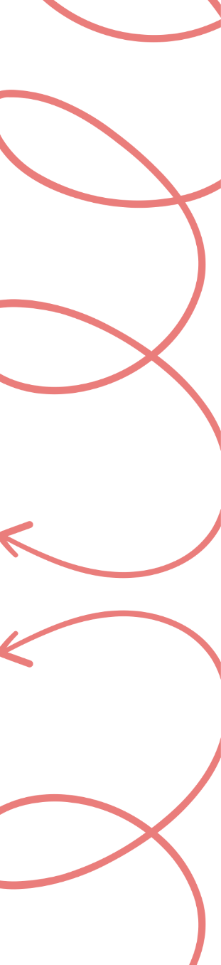



Anatomy
of the
human
heart

Slide 5
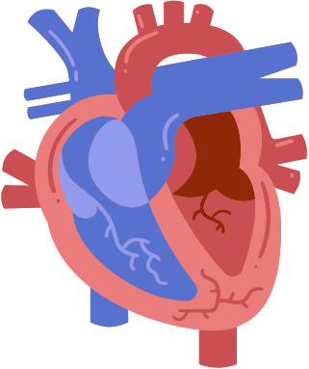
The four chambers
Label here
Label here
Introduce the heart’s four chambers: right atrium, right ventricle, left atrium, and left ventricle.
Use a diagram to label each chamber and highlight key structural differences.
Label here
Label here

Slide 6

Types of
blood vessels
Introduce the major types of blood vessels and how they connect to the heart.
Thick wall of muscle and elastic fibres
Thin wall of muscle and elastic fibres
Wall is one cell thick
Small lumen
Large lumen
Lumen
Arteries
Veins
Capillaries
Explain their structure and main function.
Explain their structure and main function.
Explain their structure and main function.

Slide 7

Epicardium
Highlight key characteristics and role.
Layers of the heart wall
Myocardium
Highlight key characteristics and role.
Endocardium
Highlight key characteristics and role.

Slide 8
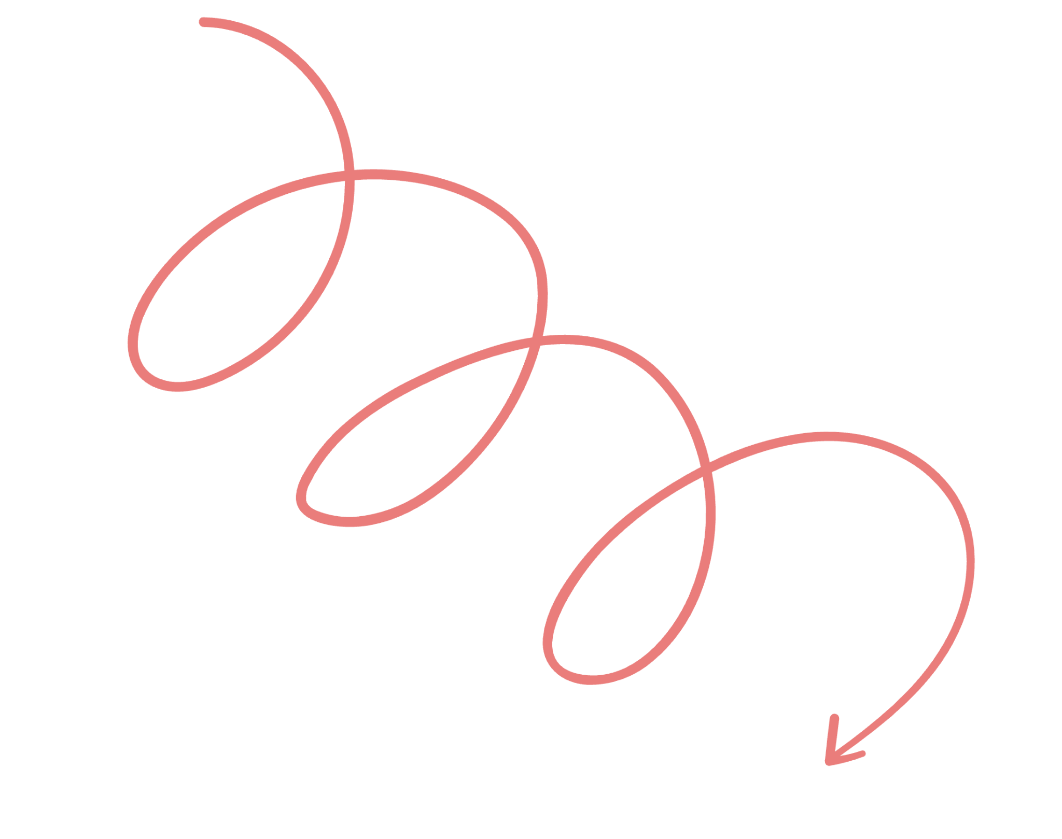
Learning check
Question goes here
Add a multiple-choice question to test learner understanding of previously discussed concepts.
Option 1
Option 2
Option 3
Option 4

Slide 9
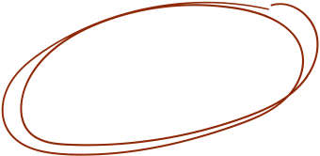
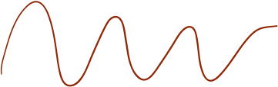

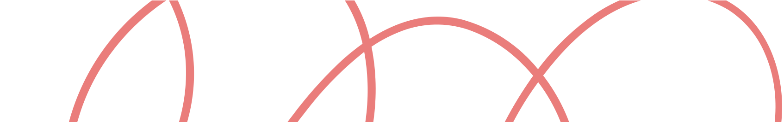
How
the
heart
works

Slide 10
How blood flows through the heart
Guide learners through the full path of blood flow. Include a diagram or flowchart to help visualize the sequence.
Oxygen-poor blood
Oxygen-rich blood
1
3
Describe how blood flows from the upper body to the left lung.
Describe how blood flows from the left lung to the rest of the body.
2
4

Slide 11
The electrical conduction system
Label here
Label here
Introduce the specialized system that controls the heartbeat.
Use a labeled diagram to show the location of key nodes and conduction pathways.
Label here
Label here

Slide 12

Steps of cardiac conduction
Show how electrical impulses move through the heart during each heartbeat.
Step 1
Step 2
SA nodes fires
Impulse reaches AV node
Add more details here.
Add more details here.
Step 3
Step 4
Impulse travels through the AV bundle
Purkinje fibers distribute impulse
Add more details here.
Add more details here.

Slide 13


Summary
Anatomy of the
human heart
How blood flows
The electrical conduction system
Highlight the heart’s major structures.
Recap the path of blood through the chambers and valves.
Explain how the heart maintains a steady and coordinated rhythm.

Slide 14






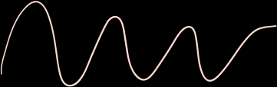
Resource Page
Use these in your presentation. Delete or hide this page before presenting.
Fonts
Design Elements / Icons
This presentation template
uses the following free fonts:
TITLES:
Martel
BODY TEXT:
Be Vietnam
You can find these fonts online too.
Colors
#FFDAD1
#EA7D7B
#DB5D24
#8F2807
#5771CF

Slide 15


Credits
This presentation template is free for everyone to use, thanks to the following:
Pexels, Pixabay, Sketchify
for this presentation template
for the photos, graphics, and elements
Happy designing!

